Slide 1


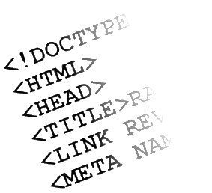

HTML Basics Course Introduction
Course Program, Evaluation, Resources
HTML Basics
Telerik Software Academy
http://academy.telerik.com

Slide 2


Table of Contents
HTML Course Curriculum
The Trainers Team
Evaluation
Learning Resources
Required software

Slide 3

HTML Course Curriculum
Coming To The Next Module

Slide 4

What's Coming Next?
HTML Introduction
Fundamental for web development
Starting of front-end track
Pretty much the same
Lectures 3 times a week
Test exam next Friday
The course exam?
35 test questions for 45 minutes
Telerik Academy Test System

Slide 5
Why HTML, CSS and JS?
HTML, CSS and JS – standard for web-based UI
Web-based applications are extremely popular
Run on anything with a browser
Windows 8 devices can run HTML, CSS and JS natively
HTML and CSS – evolving standards
JavaScript
High-level scripting language, fast to write, object-oriented, runs on client and server

Slide 6
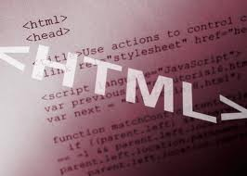


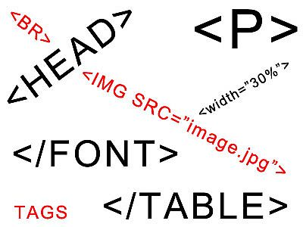

HTML Basics Program
Web Design Concepts
Tools for HTML, CSS and JS
Introduction to HTML
HTML Tables
HTML Forms
Semantic HTML
HTML Basics Test

Slide 7
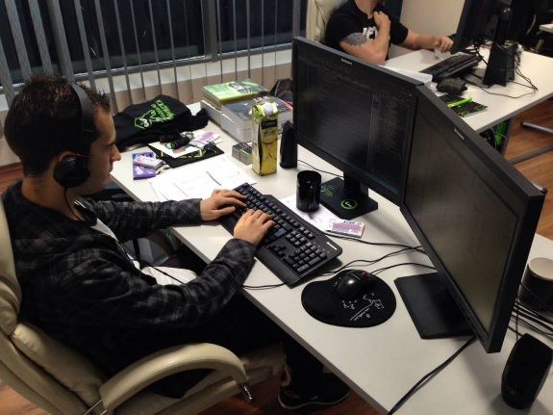
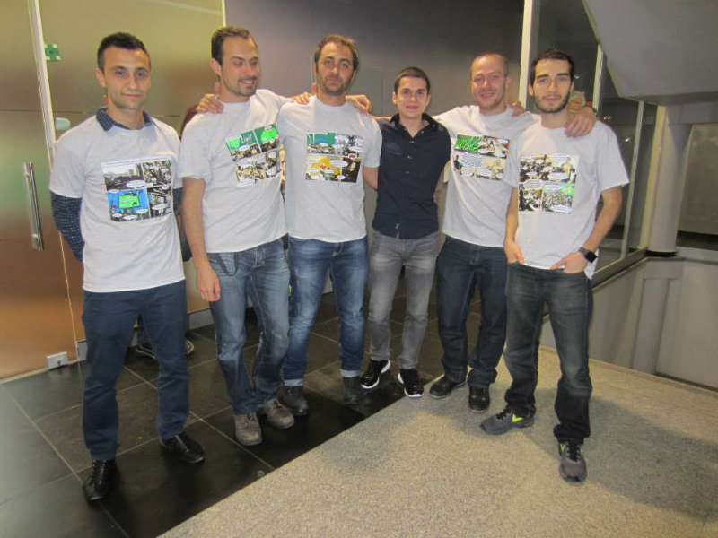
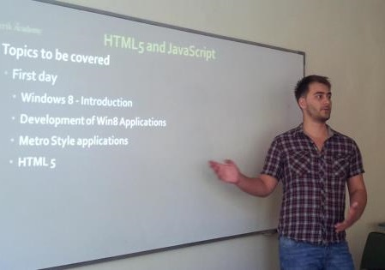
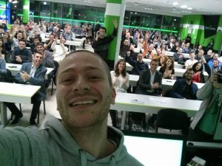
Trainers Team

Slide 8

Trainers Team
Nikolay Kostov
Manager Software Engineering @ Telerik (Progress)
Microsoft Certified Trainer (MCT)
Champion from Telerik Academy
IT and Informatics competitions winner
Student in Sofia University (Computer Science)
Email: nikolay.kostov [at] telerik.com
Blog: http://nikolay.it
GitHub: https://github.com/NikolayIT

Slide 9
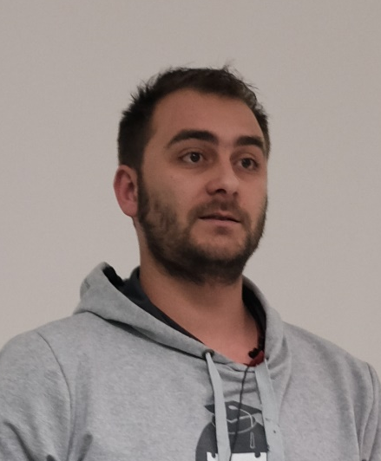
Trainers Team (2)
Doncho Minkov
Senior Technical Trainer @ Telerik Software Academy
Contestant in the Informatics competitions
Champion from Telerik Software Academy
Experience with Web and Mobile apps
Proficient with JavaScript and .NET
Email: doncho.minkov [at] telerik.com
Blog: http://minkov.it
GitHub: https://github.com/Minkov

Slide 10
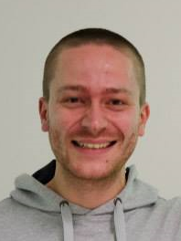
Trainers Team (3)
Ivaylo Kenov
Technical Trainer @ Telerik Academy
Mathematical competitions contestant
Champion from Telerik Software Academy
E-mail: ivaylo.kenov [at] telerik.com
Champion in OOP and DSA
Blog: http://ivaylo.bgcoder.com/
GitHub: https://github.com/ivaylokenov

Slide 11
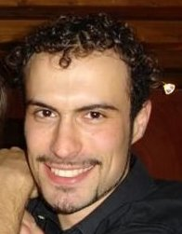
Trainers Team (4)
Evlogi Hristov
Technical Trainer @ Telerik Software Academy
Graduate from the fourth season of Telerik Software Academy
Ex-developer, Sharepoint
E-mail: evlogi.hristov [at] telerik.com

Slide 12





Evaluation
Thank God There Are Bonuses!

Slide 13

HTML Basics - Evaluation
Evaluation components
Test up to 75%
Homework – 15%
Homework evaluation – 5%
3 peer reviews per homework
Attendance in class – 5%
Bonuses
Forums activity – bonus up to 5%

Slide 14
HTML Basics Test – Sample Question
You are given the following (exact) HTML code:
<div>
<p>This is\r\n
multi-line
text</p>
</div>
What will the page text look like in a modern browser?
This is multi-line text
404 – not found
This is multi-line text
This is\r\n multi-line text

Slide 15
Homework Peer Reviews
Everyone will get feedback for their homework
Everyone will give feedback for few random homework submissions
Students submit homework anonymously
Please exclude your name from the submissions!
For each homework submitted
Students evaluate 3 random homeworks
From the same topic, after the deadline
Give written feedback, at least 200 characters
Low-quality feedback → report for punishment

Slide 16
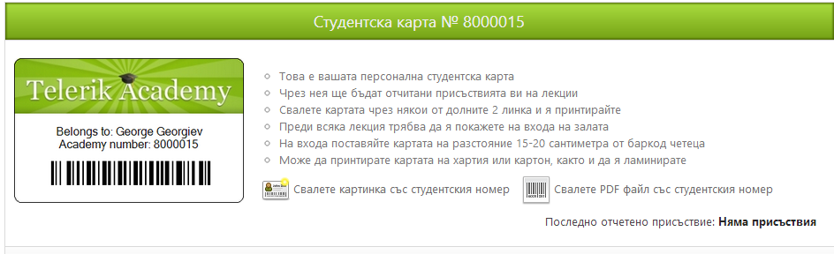
Attendance in Class
We encourage live participation
Top performers throughout the years have always spent lots of time in the academy halls
Register your presence @ barcode scanners
Last check-in is listed in your student profile
Scanners are next to the doors
Use Student ID Card
Check in +/- 30 min. before / after lecture starts

Slide 17


Pass / Excellence / Fail Criteria
Criteria for pass / pass with excellence / fail
Pass with excellence
Very high exam results
or
High total results
Pass
Average total results
Fail
Low total results or low exam results

Slide 18
Homework Assignments
Doing your homework is very important!
Programming can only be learned through a lot of practice!
After each lecture there are a few exercises
Try to solve them in class
The rest are your homework
Homework assignments due few days after each lecture – no excuses for being late
Deadlines are final & enforced by the system
Submit homework through telerikacademy.com

Slide 19








Resources
What We Need in Addition to this Course Content?

Slide 20



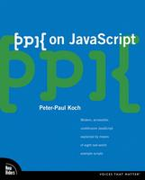
Recommended Books
“Designing with Web Standards”, Jeffrey Zeldman, New Riders Press, 2005, ISBN 9780321616951
"HTML & XHTML: The Definitive Guide, Sixth Edition", Chuck Musciano, Bill Kennedy, O'Reilly, 2006, ISBN 9780596527327
"CSS: The Definitive Guide, Third Edition", Eric Meyer, O'Reilly, 2006, ISBN 9780596527334
“PPK on JavaScript”, Peter Paul-Koch, New Riders Press, 2006, ISBN 9780321423306

Slide 21
Course Web Site & Forums
Register for the "Telerik Academy Forums":
Discuss the course exercises with your colleagues
Find solutions for the exercises
Share source code / discuss ideas
The HTML Basics official web site:
http://telerikacademy.com/Forum/Category/27/HTML-CSS
academy.telerik.com/student-courses/web-design-and-ui/html-fundamentals/about

Slide 22
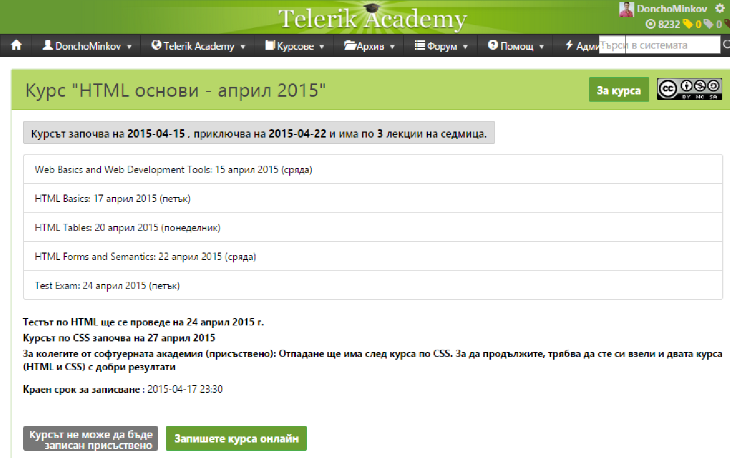
Telerik Integrated Learning System (TILS)
The Telerik Integrated Learning System (TILS)
www.telerikacademy.com
Important resource for all students
Homework submissions
Homework peer reviews
Presence cards with barcode
Reports about your results
telerikacademy.com/Courses/Courses/Details/230

Slide 23
Required Software
Software needed for this course:
Sublime Text 2/3
Notepad++
Jetbrains WebStorm
Aptana Studio
Atom
Microsoft Visual Studio 2013
Visual Studio Community 2013 (free version of VS 2013)
Any text editor that is convenient with you

Slide 24
HTML Basics Course Introduction
http://academy.telerik.com

Slide 25


Free Trainings @ Telerik Academy
"Web Design with HTML5, CSS3 and JavaScript" course @ Telerik Academy
html5course.telerik.com
Telerik Software Academy
academy.telerik.com
Telerik Academy @ Facebook
facebook.com/TelerikAcademy
Telerik Software Academy Forums
forums.academy.telerik.com

